Slide 1
Emergency epidemiology
Applying research in the midst of a pandemic – new data sources & limited time
Matthew Edwards, Willis Towers Watson Dan Ryan, COIOS Research

Slide 2
Contents
Early studies on infectiousness and mortality
Data-collection programs
Identifying mutations
The precautionary principle

Slide 3
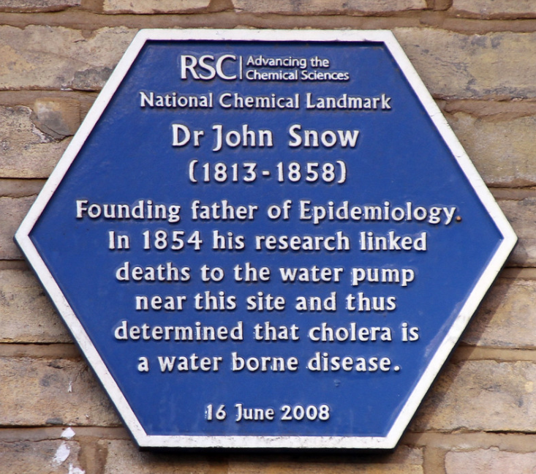
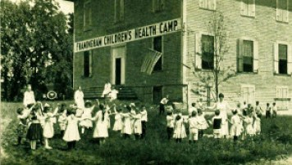
Epidemiology in the midst of crisis
Cholera (1854)
Tuberculosis (1916)
Southwark & Vauxhall Water Company
Lambeth Water
Company
Metropolitan Life
Hypertension (1948)

Slide 4
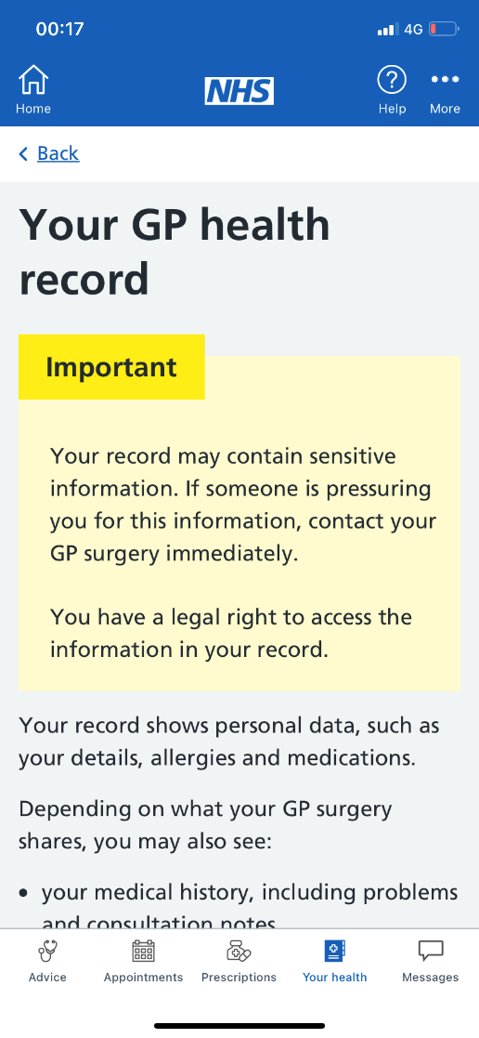
How epidemiology is being transformed by data

Slide 5
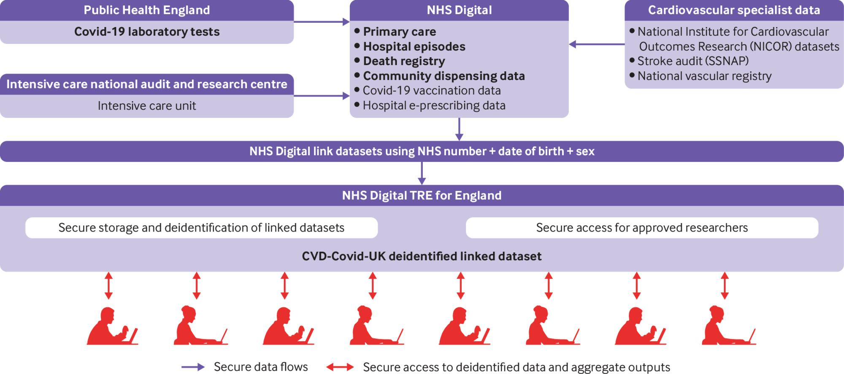
How epidemiology is being transformed by data
Source: NHS Digital Trusted Research Environment

Slide 6
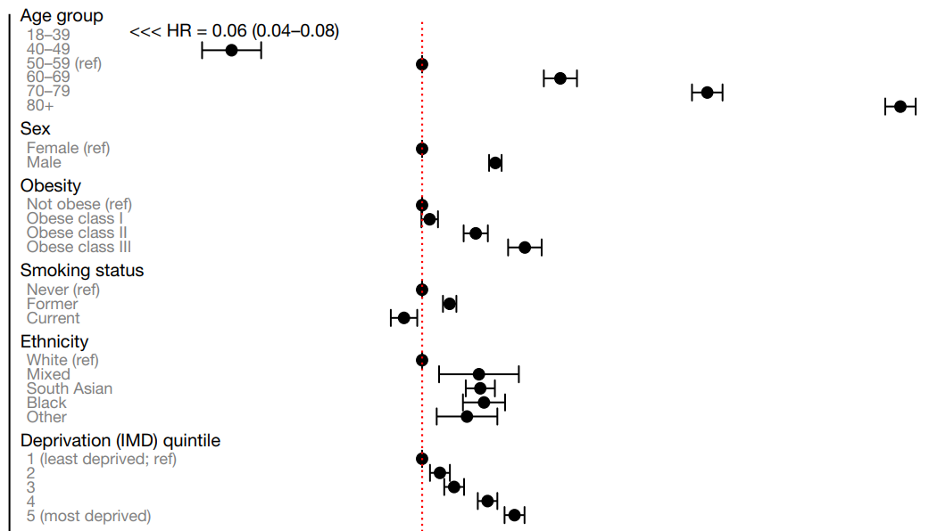
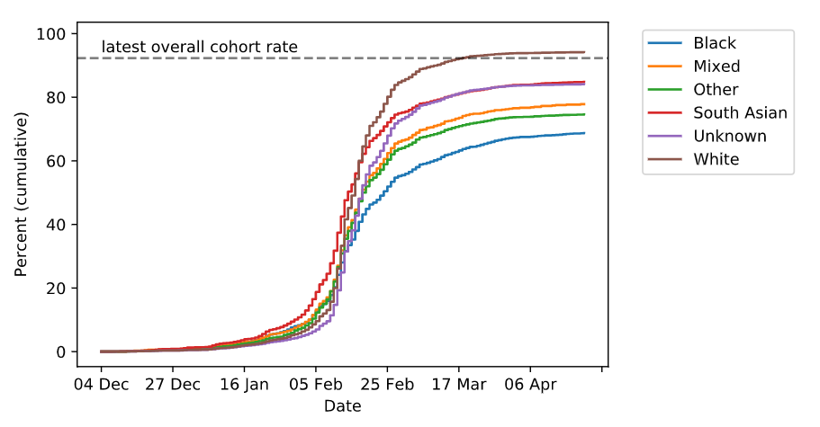
OpenSafely – using eHR to track vaccination & deaths
COVID-19 mortality risk
Pop: 17.3m, Deaths: 10.9k
Vaccination rates
Shielding population (ages 16-69)
Source: COVID Symptom Study

Slide 7
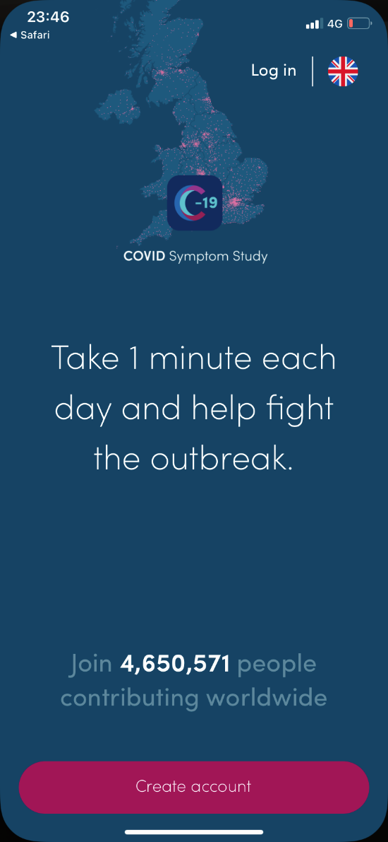
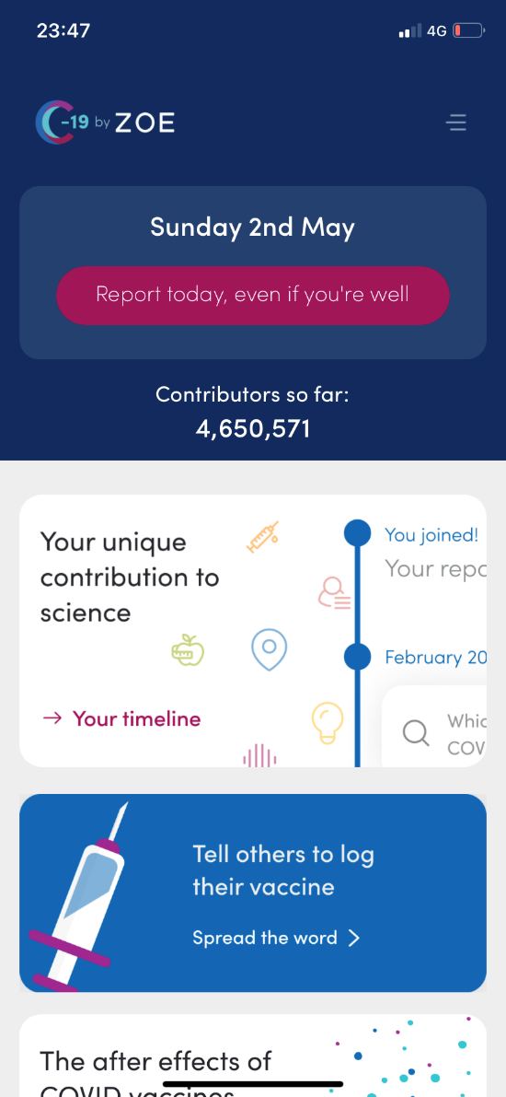
COVID Symptom Study – KCL & ZOE since March 2020
Source: COVID Symptom Study

Slide 8
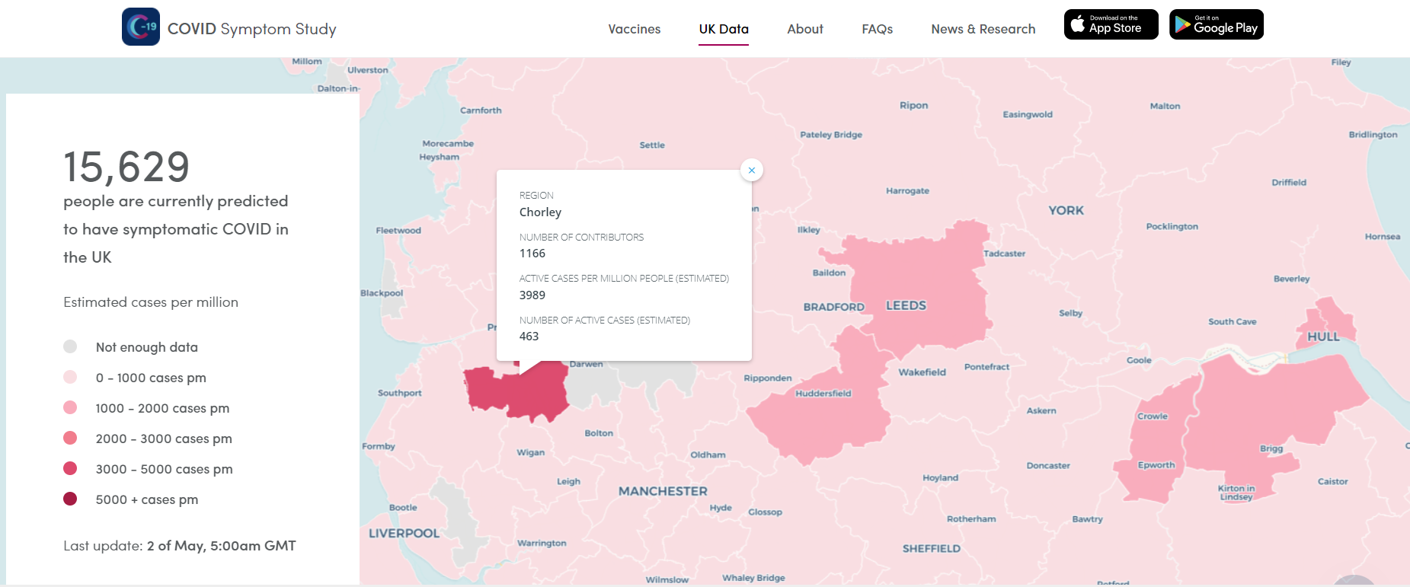
COVID Symptom Study – KCL & ZOE since March 2020
Source: COVID Symptom Study

Slide 9
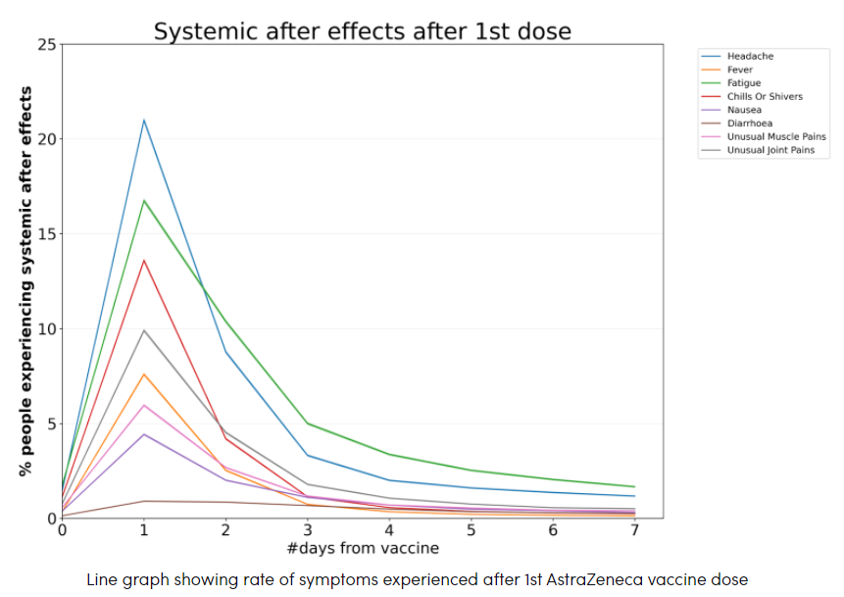
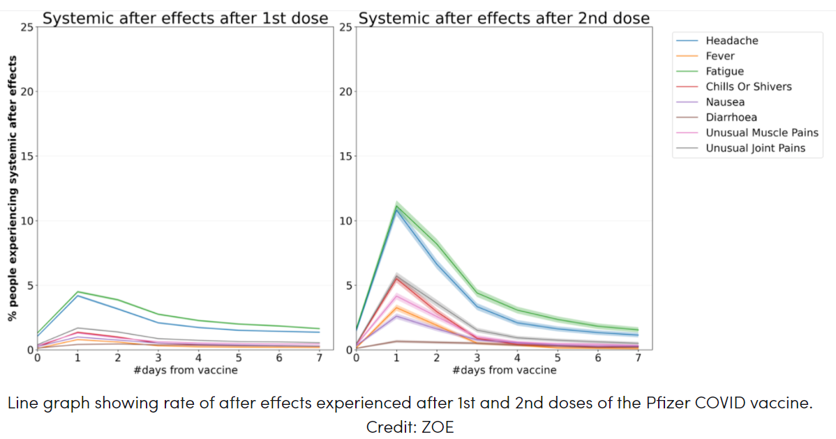
COVID Symptom Study – symptoms after vaccinations
Sources: COVID Symptom Study – Pfizer, Astrazeneca

Slide 10
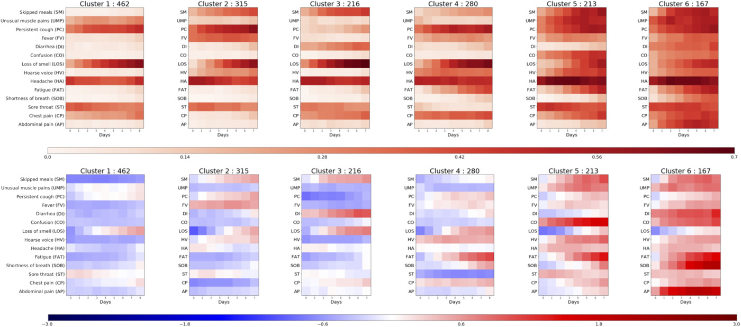
Symptom clusters in COVID
Freq
z-score
Require
respiratory
support
1.5%
4.4%
3.7%
8.6%
9.9%
19.8%
Source: COVID Symptom Study app – symptom clusters

Slide 11
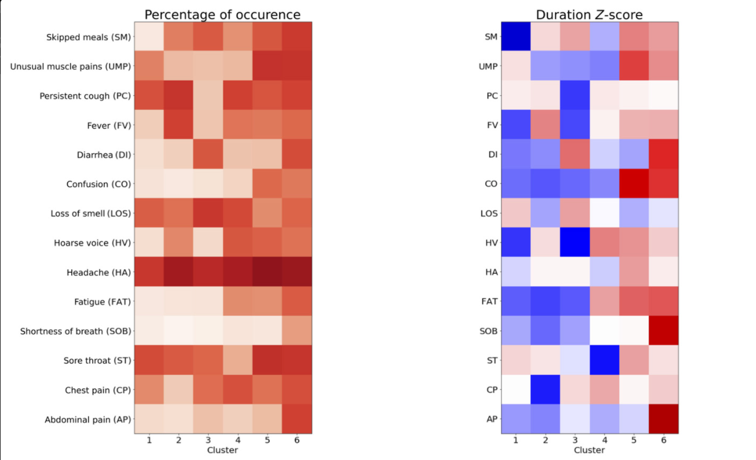
Symptom clusters in COVID
Source: COVID Symptom Study app – symptom clusters

Slide 12
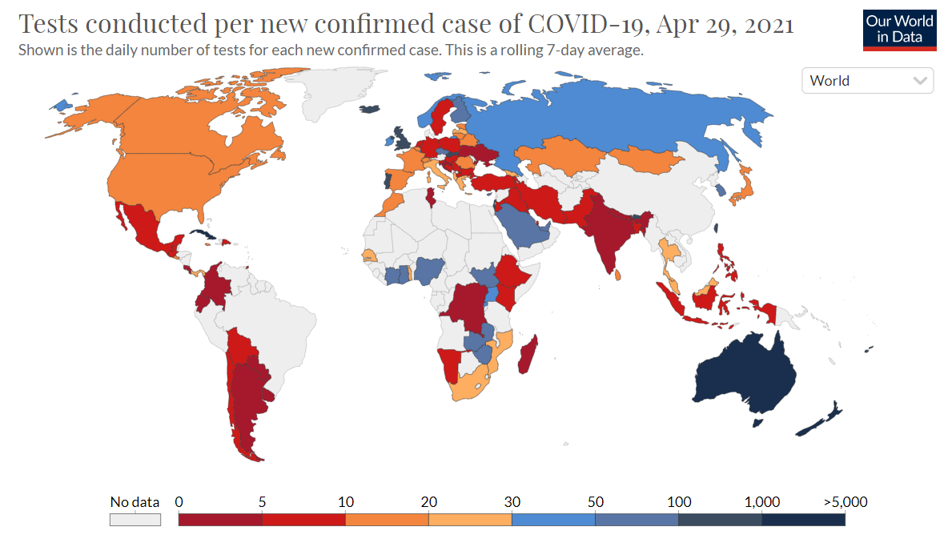
Testing & tracing around the world
Source: OurWorldInData

Slide 13
Testing & tracing around the world
UK pillars of testing
Category | Purpose | Cumul. as at 29 Apr
Pillar 1 | Swab testing in PHE & NHS labs | 24,962,445
Pillar 2 | Swab testing for wider population | 122,013,210
Pillar 3 | Antibody serology testing | 2,167,115
Pillar 4 | Surveillance programme – blood & swab testing | 7,160,054
Source: NHS Test and Trace

Slide 14
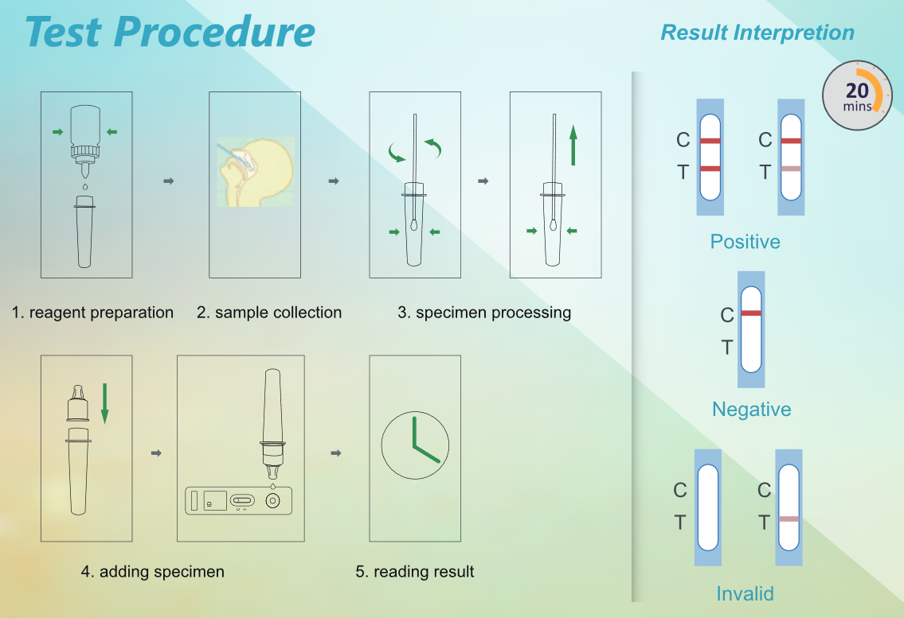
Weak link or vital cog - lateral flow tests
26 million carried out from 8 March – 4 April
- 31,000 positive tests, 18% negative on follow up PCR
2x weekly testing available to everyone from 5 April
Litany of problems
Operator error
Cumbersome reporting
Disincentives to honesty
More likely to miss asymptomatic cases
% false positives when prevalence rates low
BUT lower cost, highly scalable
Source: Cambridge Bioscience

Slide 15
Mutations, variants & how they are classified
Variants under investigation (VUI)
Variants with epidemiological, immunological or pathogenic properties
Variants of concern (VOC)
VUI that have undergone risk assessment
Variants of high consequence (VOHC)
VOC where clear evidence that prevention measures have significantly reduced effectiveness relative to previously circulating variants
Mutation hotspots
Source: SARS-CoV-2 mutation hotspots

Slide 16
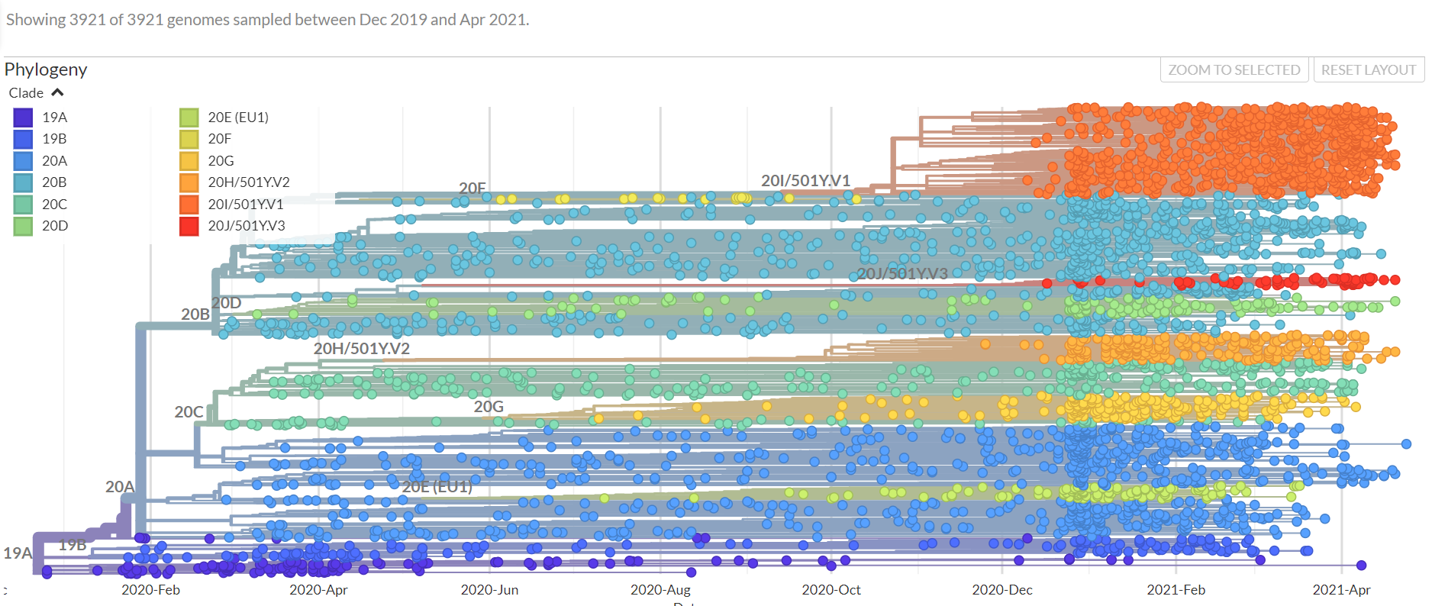
Continuous evolution of SARS-CoV-2 virus
Source: Nextstrain.org

Slide 17
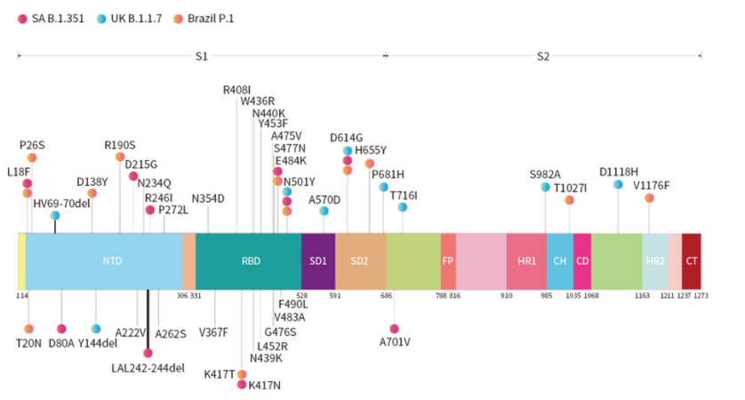
Evolving structure of SARS-CoV-2 virus
Sources: Emerging mutants from SARS-CoV-2 variants, Convergent evolution of N510Y lineages

Slide 18
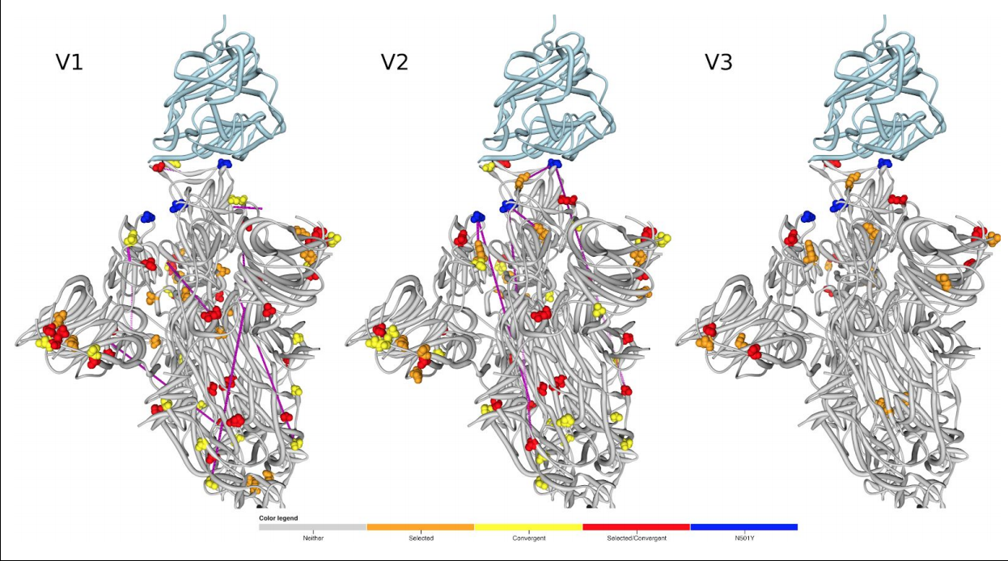
Evolving structure of SARS-CoV-2 virus
Sources: Emerging mutants from SARS-CoV-2 variants, Convergent evolution of N510Y lineages

Slide 19
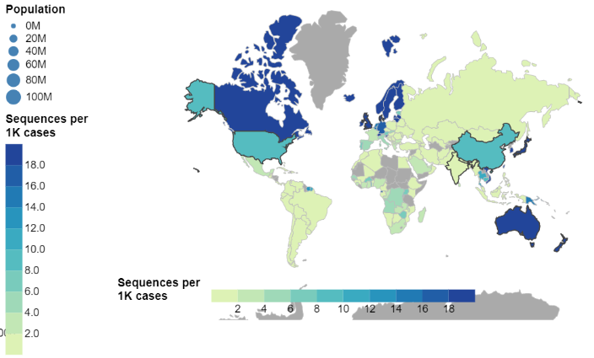
Global picture on sequencing variants
Country | Sequenceper 1k cases
Iceland | 727
Australia | 472
UK | 79.5
USA | 8.59
France | 3.49
South Africa | 2.59
India | 0.55
Russia | 0.51
Brazil | 0.32
Source: Global sequencing coverage

Slide 20
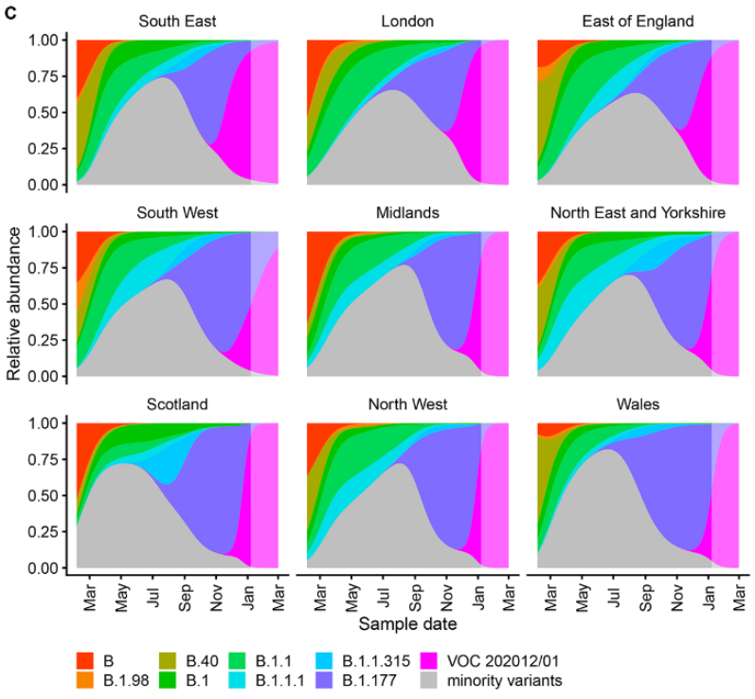
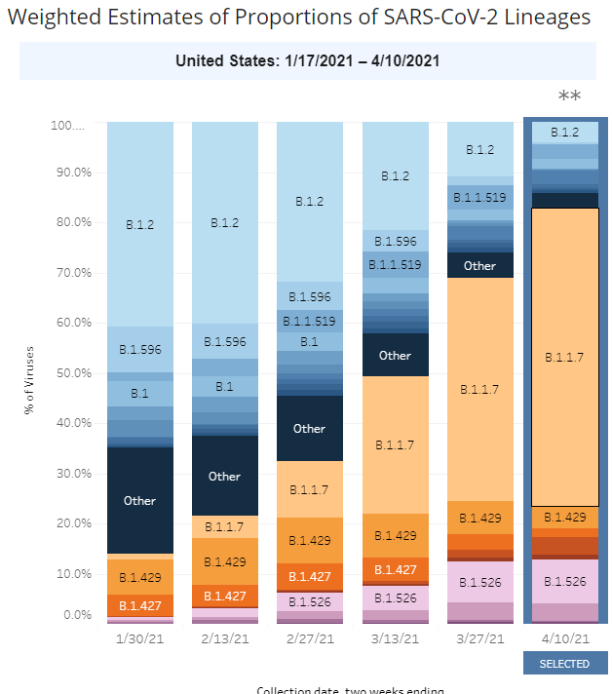
Rapid spread of VOC 202012/01 variant in UK and USA
Sources: Estimated transmissibility and impact of SARS-CoV-2 lineage B.1.1.7 in England, CDC COVID Data Tracker

Slide 21
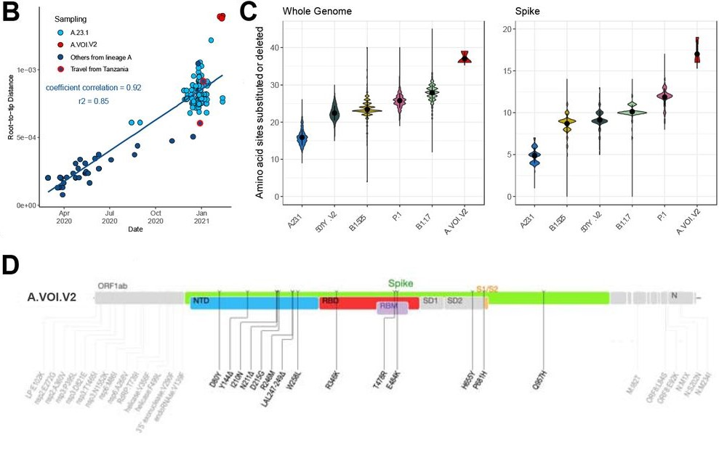
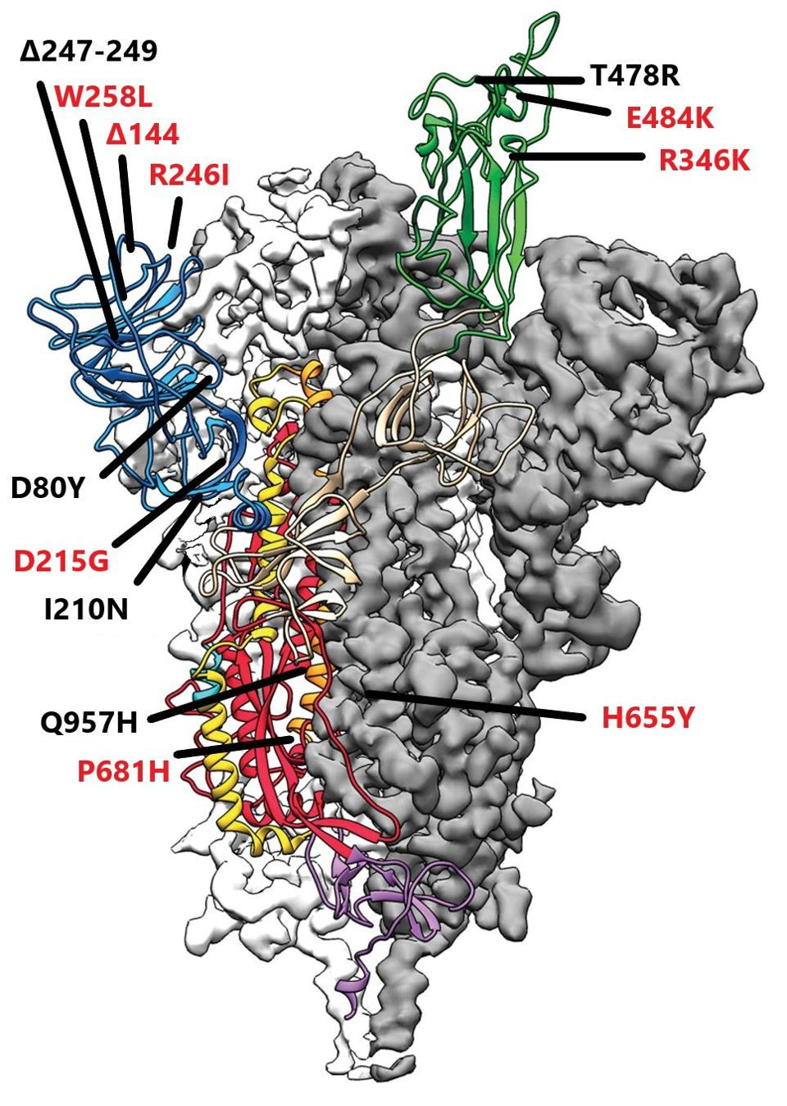
The battle continues ..new variants, multivalent vaccines
Source: Novel variant of interest from Tanzania

Slide 22
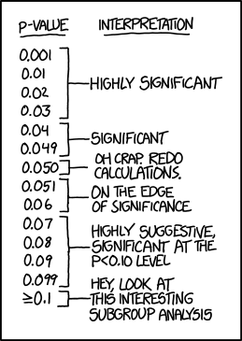
Decision-making in a time of crisis – how precautious?
The precautionary principle
Actuaries will be familiar with this from significance testing
We assume a possible factor [or similar] is irrelevant unless we have strong statistical evidence
R.A. Fisher suggested this approach in 1925 (Statistical Methods for Research Workers)
5% widely used since (although Fisher not particularly wedded to it)
Starts with the (a priori) assumption that the status quo is ‘correct’
We might start from a different position

Slide 23
The precautionary principle in epidemiology
‘First, do no harm’ (Hippocrates?)
If a new treatment is being investigated, we assume ‘guilty’ until proven ‘innocent’
Hence the system of clinical trials, and then follow-up ‘real world’ studies with particular regard to side-effects and ages (or circumstances) outside the clinical trial settings
This assumes that the new treatment/drug may be materially harmful
Explains popularity of ‘repurposing’ – if we know something has already been shown not to be harmful
However, how this works depends entirely on the starting point
In environmental policy, the 1992 Rio Declaration on Environment and Development states: ‘Where there are threats of serious or irreversible damage, lack of full scientific certainty shall not be used as a reason for postponing cost-effective measures to prevent environmental degradation’

Slide 24
Face masks in the fight against the coronavirus
Two contrary thought processes possible:
Assume face masks may be beneficial (overall – even if unclear who benefits most) and there is no serious question of harm (innocent until proven guilty)
Assume face masks are like any other treatment where we need to amass evidence to prove their worth (guilty until proven innocent)
Piece in British Medical Journal 9 April 2020 summarised known evidence on face masks (five peer-reviewed systematic reviews, generally weak conclusions)
But the note concluded recommending mandatory face masks for a range of wider reasons
www.bmj.com/content/369/bmj.m1435asdf
2020 | Countries
March | Venezuela, Czech, Italy (regional)
April | Cuba, Colombia, Austria, Turkey, Israel, Poland, Germany
May | France, Spain, Pakistan
June | England (public transport)
July | England (shops)

Slide 25
Vaccines: one dose or two dose? – initial reactions
The mainstream vaccines were all based on a two-dose strategy (three weeks apart)
On 22 December, Tony Blair suggested Britain move to vaccinate as many people as possible quickly with one dose
Professor Wendy Barclay (department of infectious disease at Imperial College London), said Mr Blair's idea was interesting but … "too risky“ (www.bbc.co.uk/news/uk-politics-55410349)
Professor Neil Ferguson (Imperial), added that the UK regulator had authorised the vaccine on the basis of two doses – one dose would require "an entirely different regulatory submission"
‘Seems a sensible tactic in terms of getting as many people as possible protected now’ (Prof Peter Openshaw (Experimental Medicine, Imperial) (www.sciencemediacentre.org)
‘This is not a question with a simple answer.’ (Prof Evans, Pharmacoepidemiology, LSH&TM)
Joint Committee on Vaccination and Immunisation (JCVI) gave go-ahead to the one-dose approach on 30 December 2020

Slide 26
Vaccines: one dose or two dose? – initial calculations
Pfizer results show efficacy of
74% after the first dose (JCVI adjustment of original 52% to allow for some trial volunteers with COVID pre-vaccination)
95% after the second dose.
Consider how many cases of COVID-19 are prevented for a given number of doses, if we have 1,000 doses and 1,000 people. Assume that each person would be materially exposed to the coronavirus and have no prior immunity.
www.covid-arg.com/post/a-bird-in-the-hand-or-two-in-the-bush
Vaccine strategy | At risk of severe COVID-19 | Not at risk of severe COVID-19
Two Doses (500 vaccinated, 500 not) | 25 from the vaccinated group 500 from the unvaccinated group | 475 from the vaccinated group
One Dose (all 1,000 vaccinated) | 260 from the vaccinated group | 740 from the vaccinated group

Slide 27
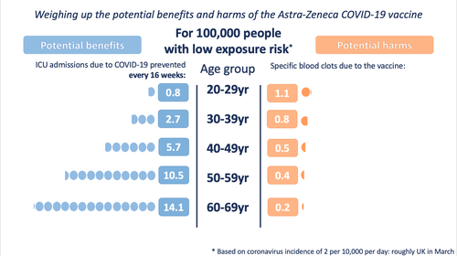
Vaccines and blood clots
Widespread concern around increased risk of blood clots from the AstraZeneca vaccine
Key issue here is what we compare the AZ vaccine blood clot risk against:
‘Nothing’ (in the ideal world, absent COVID-19, implied by some European pronouncements)
Coronavirus (associated with a high risk of blood clots, ‘inter alia’)
Other drugs that society has generally accepted
www.hamiltonhealthsciences.ca/share/blood-clot-astrazeneca-vaccine-safety, wintoncentre.maths.cam.ac.uk/news/communicating-potential-benefits-and-harms-astra-zeneca-covid-19-vaccine/

Slide 28
Further information
Our related article in IFoA Longevity Bulletin
www.actuaries.org.uk/learn-and-develop/research-and-knowledge/our-journals-and-research-publications/longevity-bulletin/longevity-bulletin-pharmacology-issue-issue-12
Our related presentation at IFoA mortality/longevity event summer 2020
www.actuaries.org.uk/learn-and-develop/online-learning-video-resources/mortality-and-demographics
COVID-19 Actuaries Response Group
www.covid-arg.com

Slide 29
Questions
Comments
Expressions of individual views by members of the Institute and Faculty of Actuaries and its staff are encouraged.
The views expressed in this presentation are those of the presenter.
Very happy to answer any further questions you may have after the event. Please contact us at:
Matthew Edwards matthew.edwards@willistowerswatson.com Dan Ryan dan.ryan@coios.health

