Slide 1
Social Care in the time of COVID
What we have learned from the pandemic and what lies ahead
Dan Ryan, COIOS Research & COVID-19 Actuaries Response Group

Slide 2
What we will cover today
Charting the epidemiology of outbreaks in care homes in UK
International dimension and learnings from contrasting experience
Initiatives taken by care homes to limit further outbreaks
Threats to viability of care home sector
Longer term funding challenges for adult social care

Slide 3
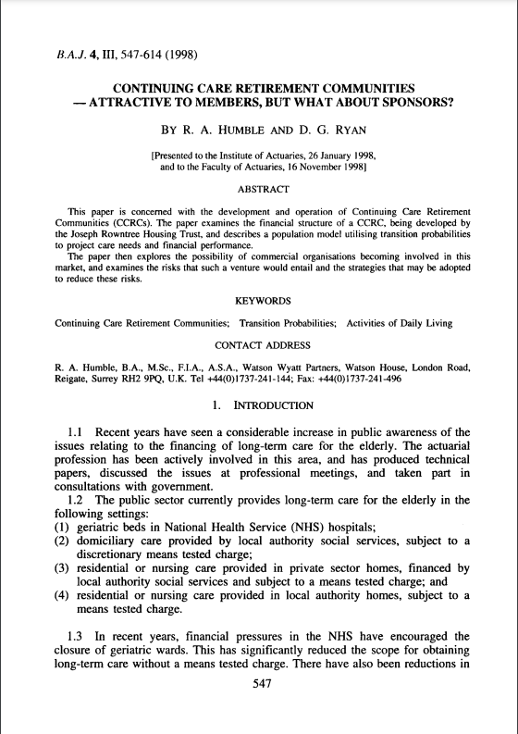
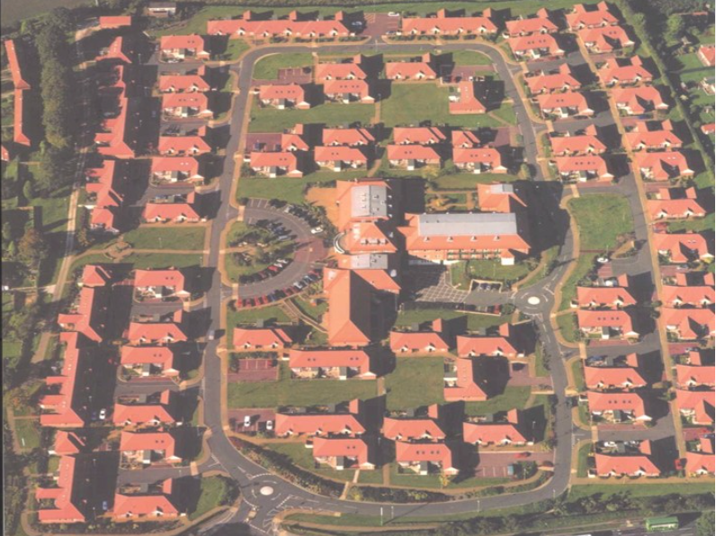
Continuing Care Retirement Communities
Hartrigg Oaks, Joseph Rowntree Housing Trust

Slide 4
Overview to Social Care
Social care setting | Number of people receiving care in the UK | Data source
Care home | 411,000 | London School of Economics
Domiciliary care | 500,000 | UK Home Care Association (UKHCA)
Community-based care and support at home | 417,910 | NHS Confederation 2012/2013
More people receive care in their own home than in a care home
1.5 million people are employed in the adult social care
9.1 million unpaid carers pre-pandemic, plus 4.5 million new carers during pandemic

Slide 5
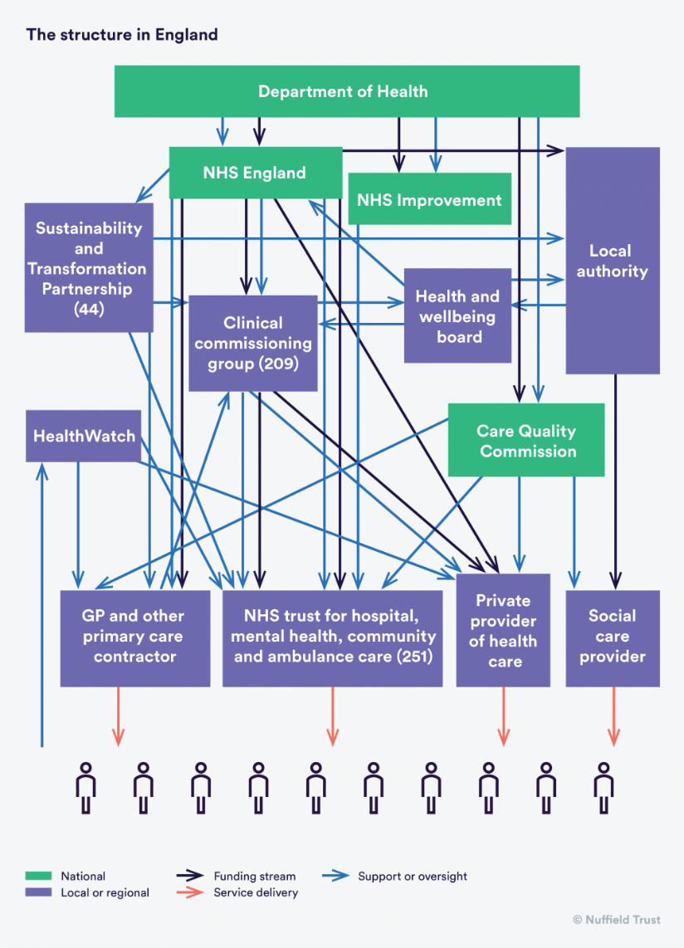
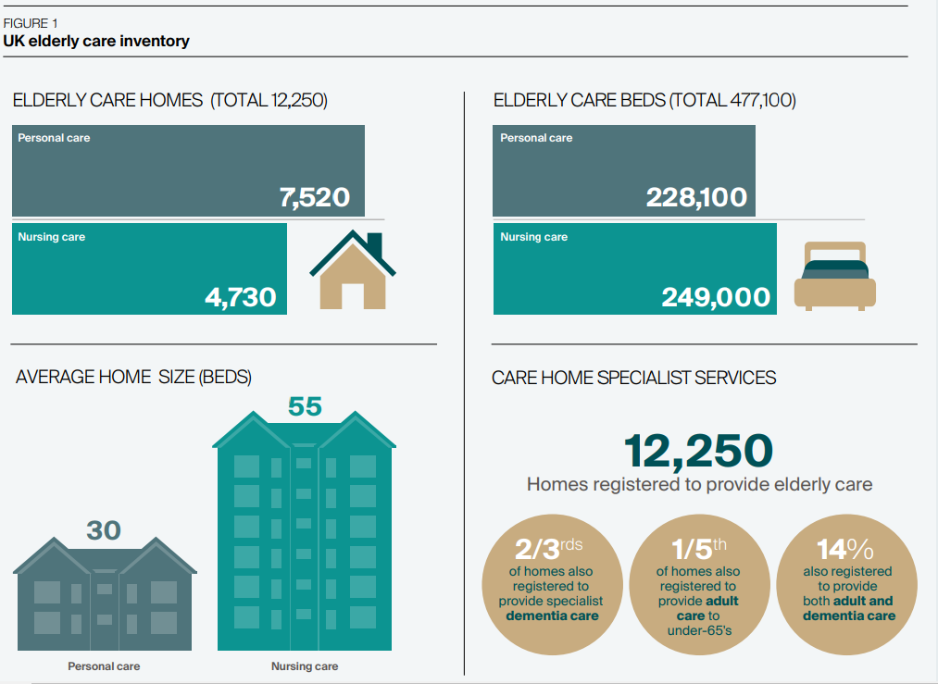
UK Department of Health and Social Care
Source: Knight Frank Research

Slide 6
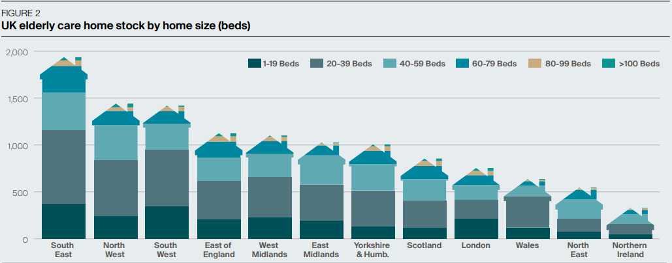
UK Department of Health and Social Care
Source: Knight Frank Research

Slide 7
UK care homes during pandemic

Slide 8
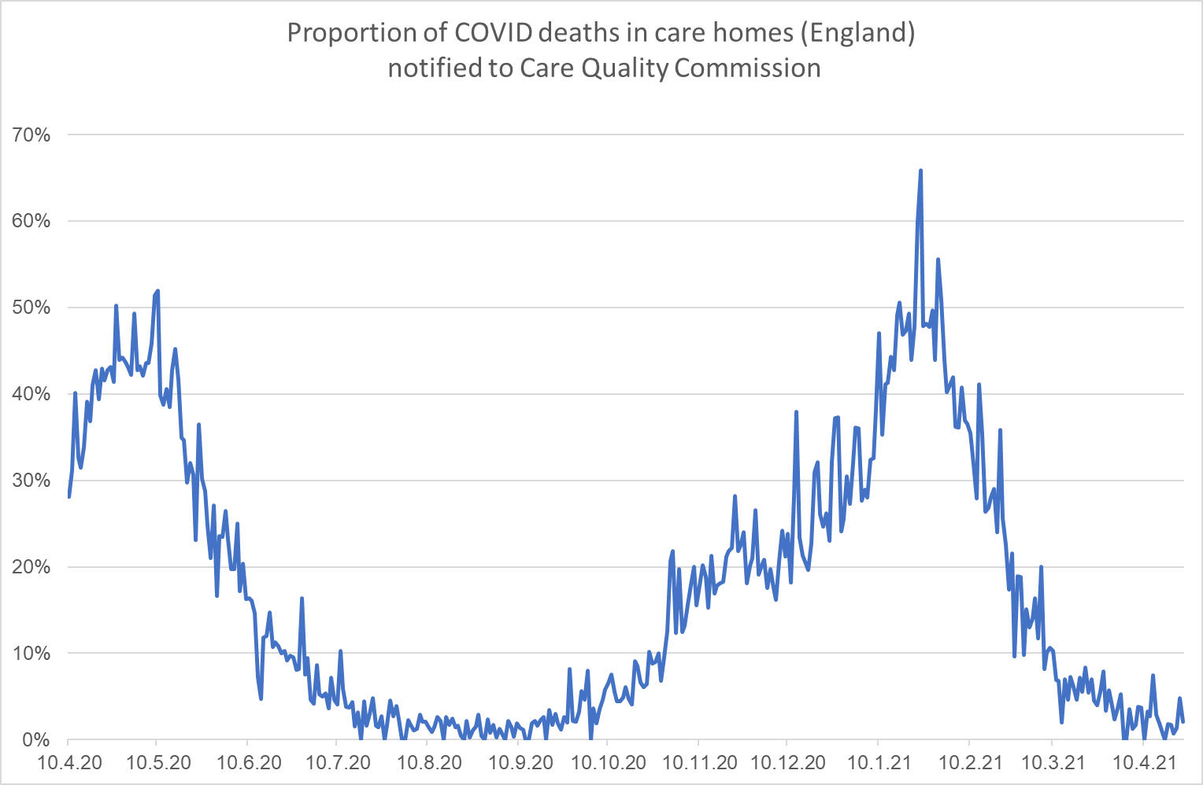
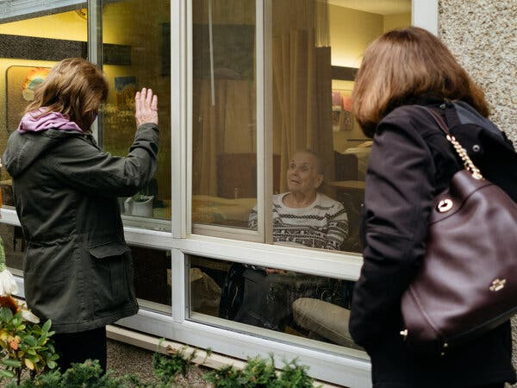
COVID – charting an “annus horribilis” for care homes
COVID-19 deaths
Other deaths
29,009
125,447
notified to CQC between 10 Apr 2020 and 9 Apr 2021
Source: Care Quality Commission

Slide 9
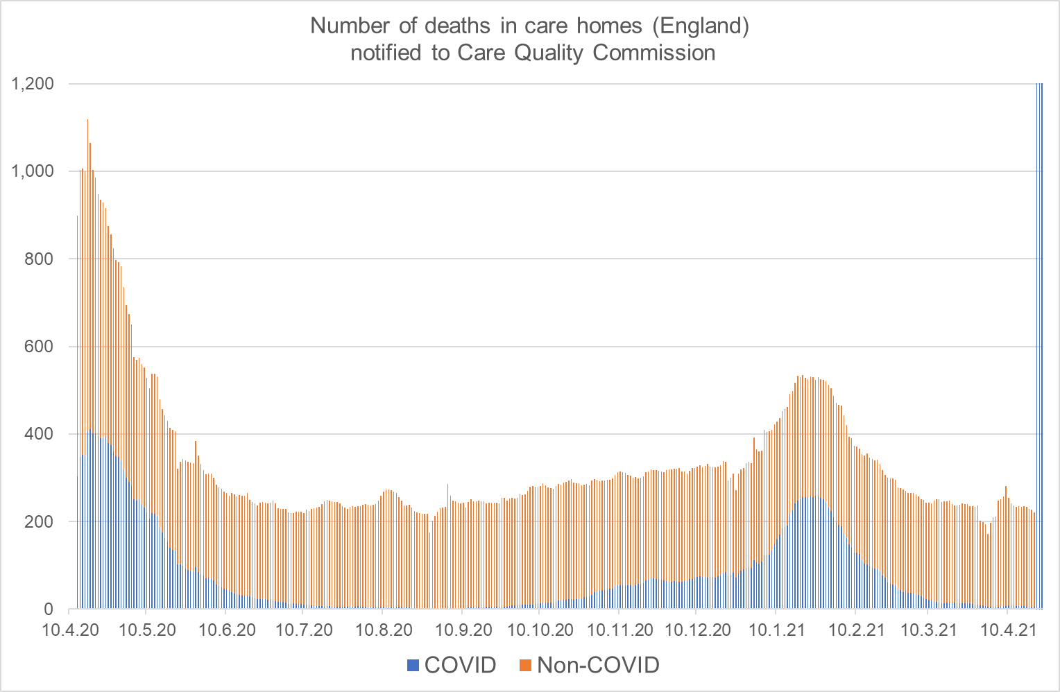
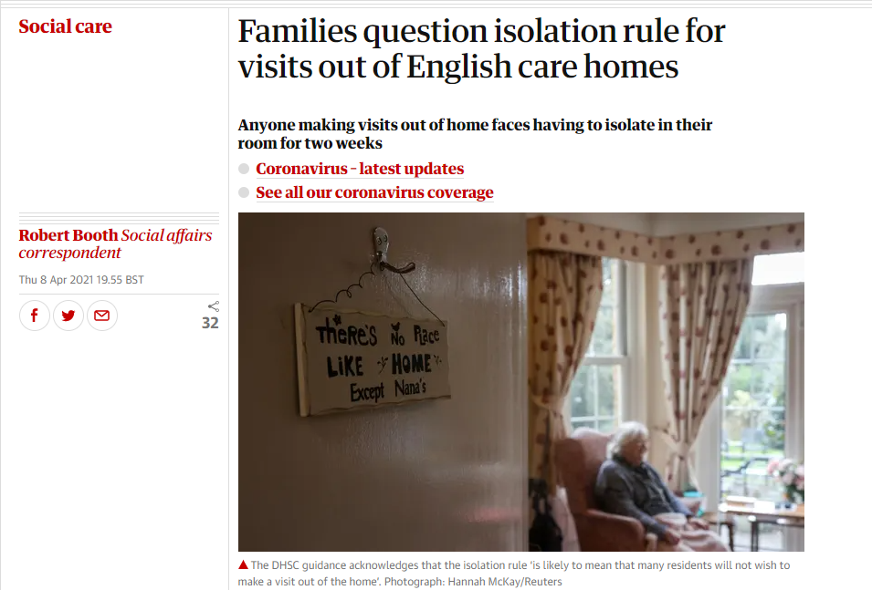
COVID – charting an “annus horribilis” for care homes
Source: Care Quality Commission, TheGuardian

Slide 10
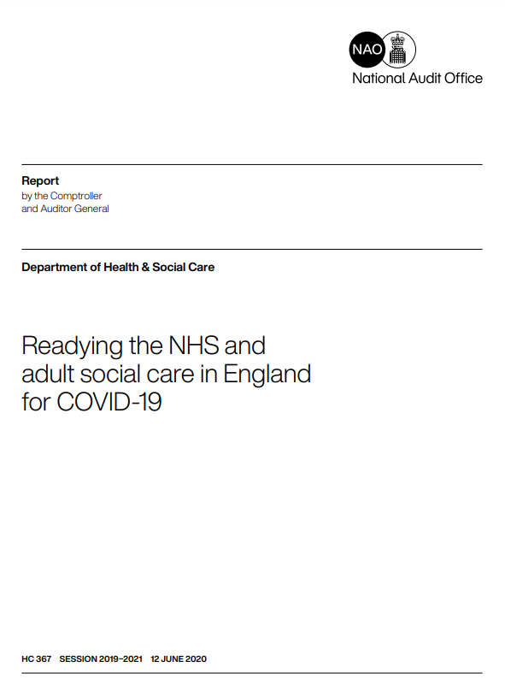
Readying the NHS and social care for the peak
Action Plans
(Early Feb) Weekly briefings to NHS leaders
(17 March) letter to NHS providers and commissioners
(15 April) Action Plan for Adult Social Care
25,000 patients discharged from hospitals to care homes between 17 March and 15 April to increase capacity without policy to test prior to discharge
Limited testing capacity in March focused on NHS hospitals
No-one tasked with responsibility for ensuring sufficient PPE until mid-April
15 May: Plan for asymptomatic testing in care homes announced (only rolled out in September)
Source: Readying the NHS and social care for the COVID-19 peak

Slide 11
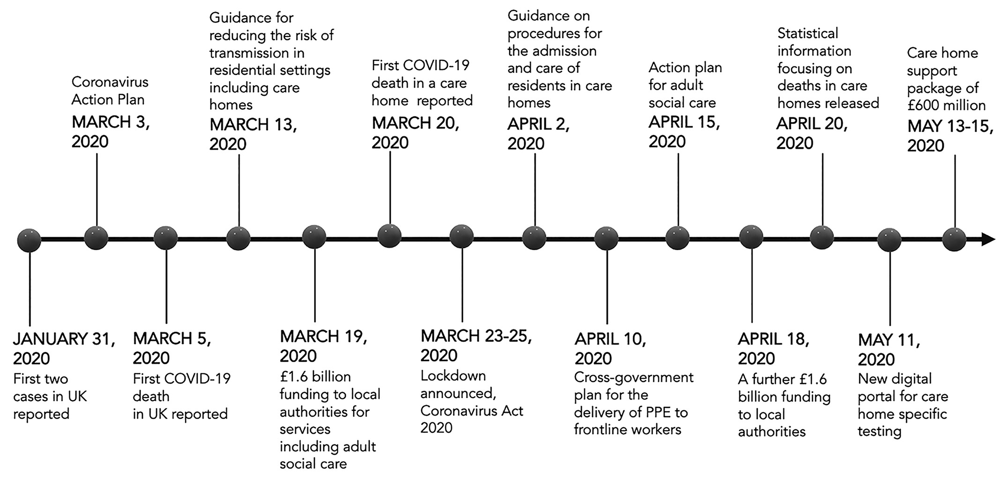
Readying the NHS and social care for the peak
Action Plans
(Early Feb) Weekly briefings to NHS leaders
(17 March) letter to NHS providers and commissioners
(15 April) Action Plan for Adult Social Care
25,000 patients discharged from hospitals to care homes between 17 March and 15 April to increase capacity without policy to test prior to discharge
Limited testing capacity in March focused on NHS hospitals
No-one tasked with responsibility for ensuring sufficient PPE until mid-April
15 May: Plan for asymptomatic testing in care homes announced (only rolled out in September)
Source: Readying the NHS and social care for the COVID-19 peak

Slide 12
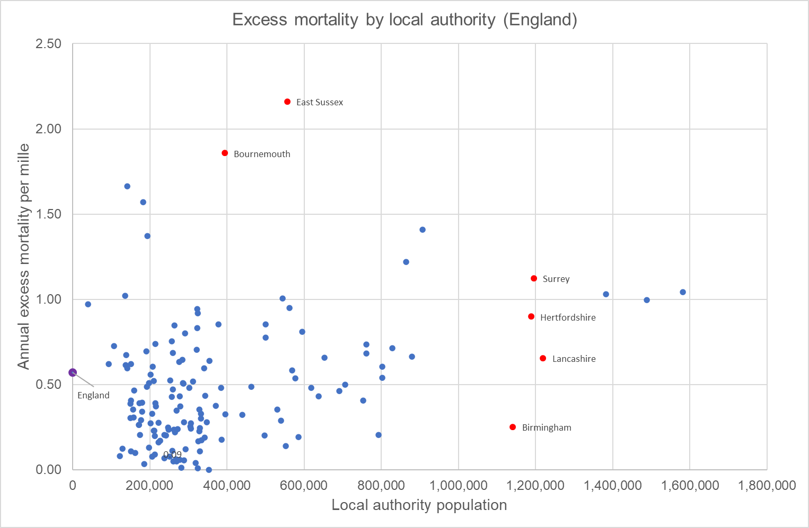
Local patterns in COVID mortality in 2021
Source: Care Quality Commission, analysis by COIOS Research

Slide 13
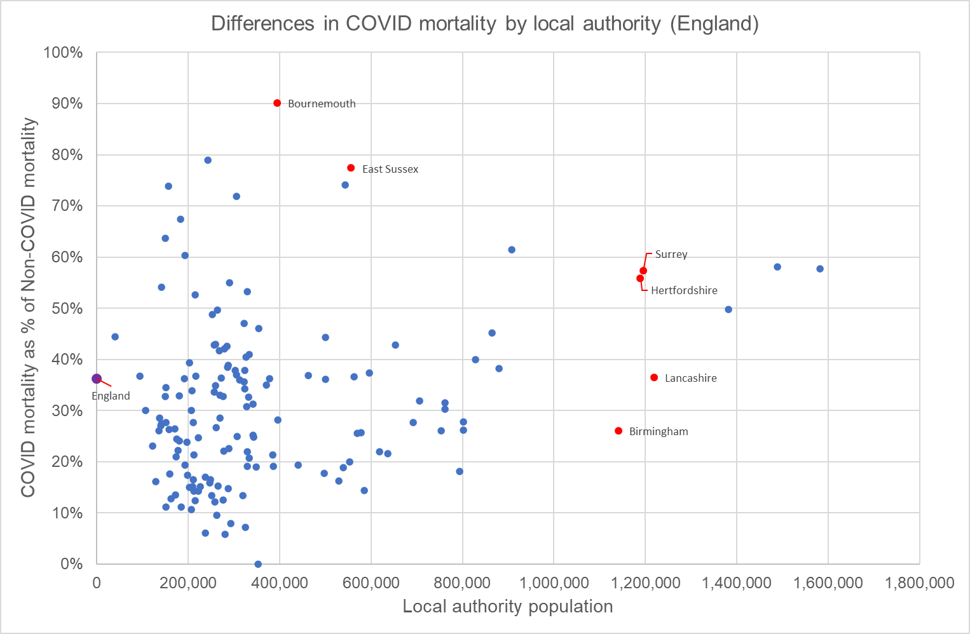
Local patterns in COVID mortality in 2021
Source: Care Quality Commission, analysis by COIOS Research

Slide 14
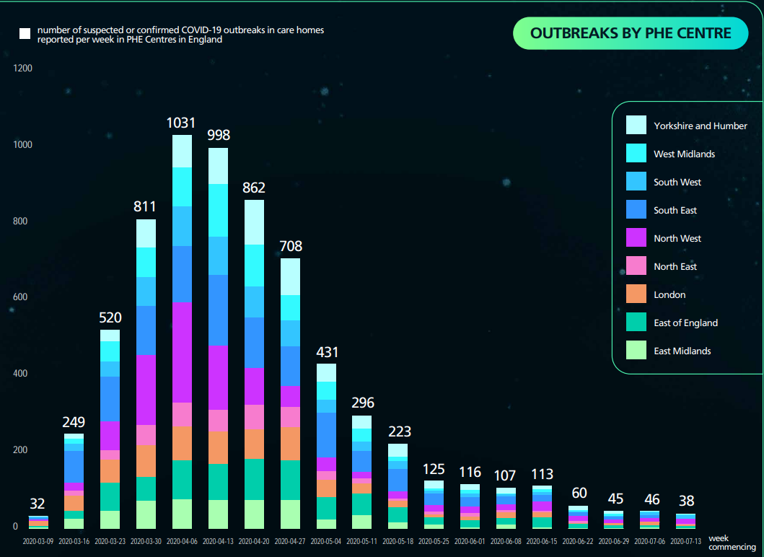
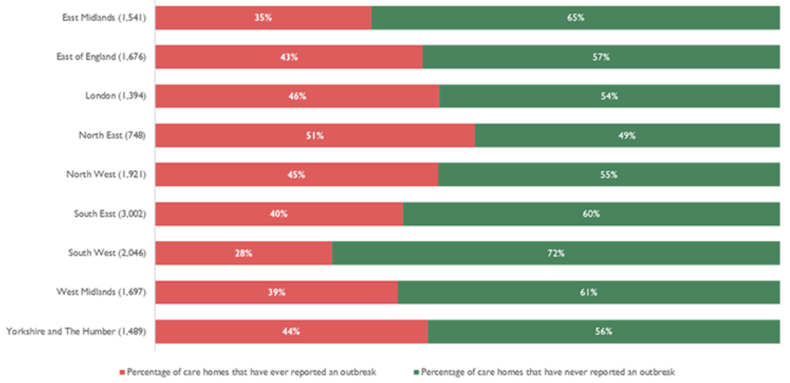
Outbreaks and contagion in care homes in England
Sources: PHE Care Home Weekly Summary Data Report, PHE Our Data from COVID-19 Insight: Issue 2

Slide 15
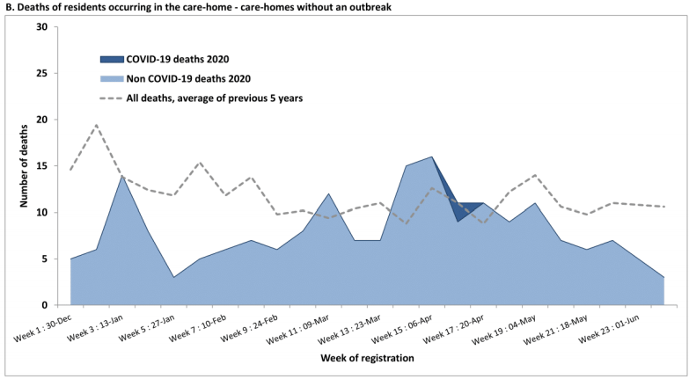
Outbreaks and contagion in care homes in Scotland
Longitudinal study of care homes in a Scottish health board
Source: Evolution and impact of COVID-19 outbreaks in care homes: population analysis in 189 care homes in one geographic region

Slide 16
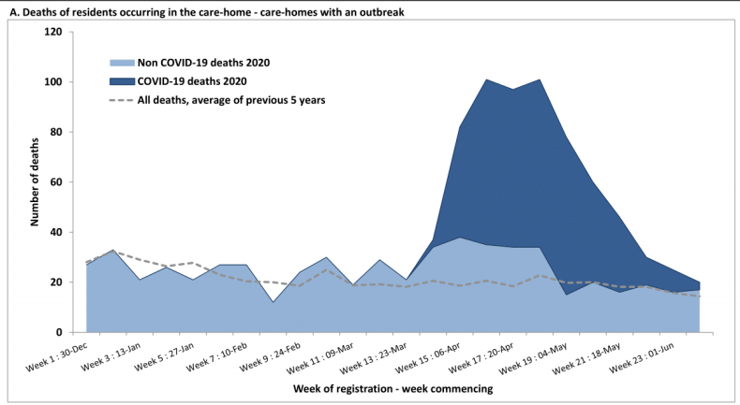
Outbreaks and contagion in care homes in Scotland
Longitudinal study of care homes in a Scottish health board
Source: Evolution and impact of COVID-19 outbreaks in care homes: population analysis in 189 care homes in one geographic region

Slide 17
Vivaldi study - COVID infection in care homes
Vivaldi is a multi-stage study involving UCL, Four Seasons healthcare and the Department of Health and Social Care. Aims of the study were to use national samplings of care home staff and residents to determine:
how many care home staff and residents were infected with COVID-19 in the past
how many care home staff and residents are infected now
how does antibody effectiveness change over time
Testing from the survey in Vivaldi 1 indicated that:
2.4% of all tests were positive (9,674 out of 397,197)
3.9% of residents tested positive (6,747 out of 172,066)
3.3% of asymptomatic residents tested positive (5,455 out of 163,945)
80.9% of residents who tested positive were asymptomatic (5,455 out of 6,747)
1.2% of asymptomatic staff tested positive (2,567 out of 210,620)
Key risk factors to infection include: use of agency staff, number of new admissions and return to care home from hospital
Source: Vivaldi study – COVID infection in care homes

Slide 18
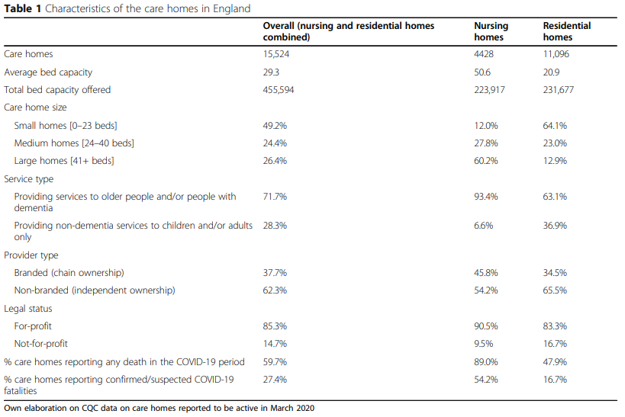
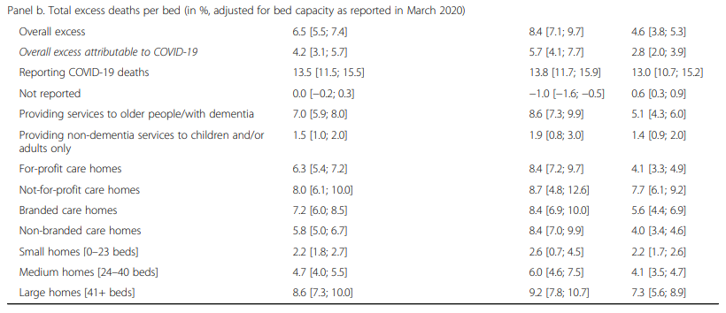
Explanation of excess mortality during 1st wave
Source: Excess mortality for care home residents in England during first 23 weeks of COVID-19 pandemic

Slide 19
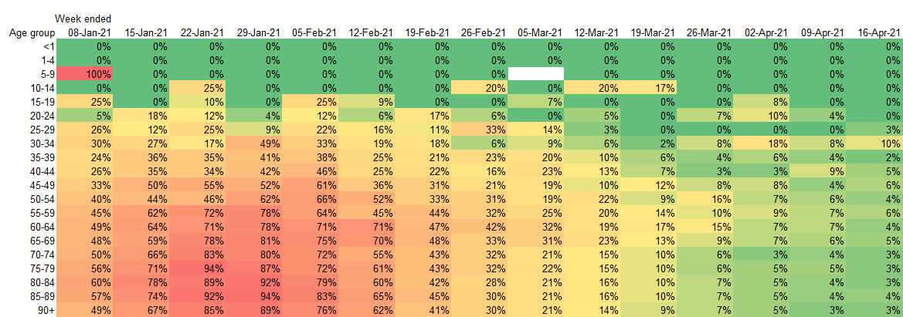
End of 2nd wave – benefits of lockdown & vaccination
COVID registered deaths as % of Non-COVID deaths in each week
Source: ONS weekly provisional deaths for England & Wales

Slide 20
International dimension

Slide 21
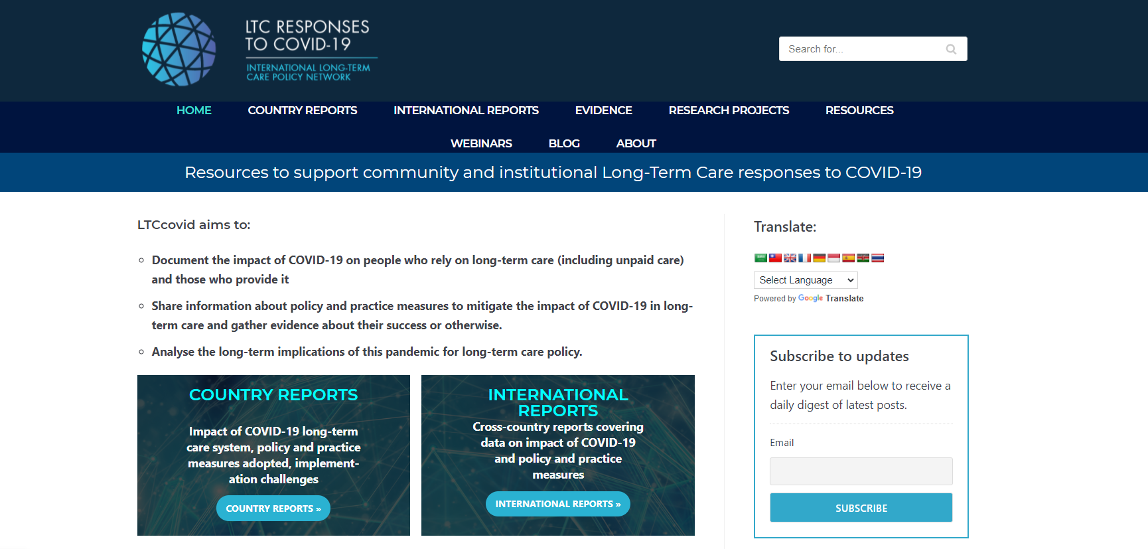
Boundless thanks to LTCCOVID.org
Source: LTCCOVIG.org

Slide 22
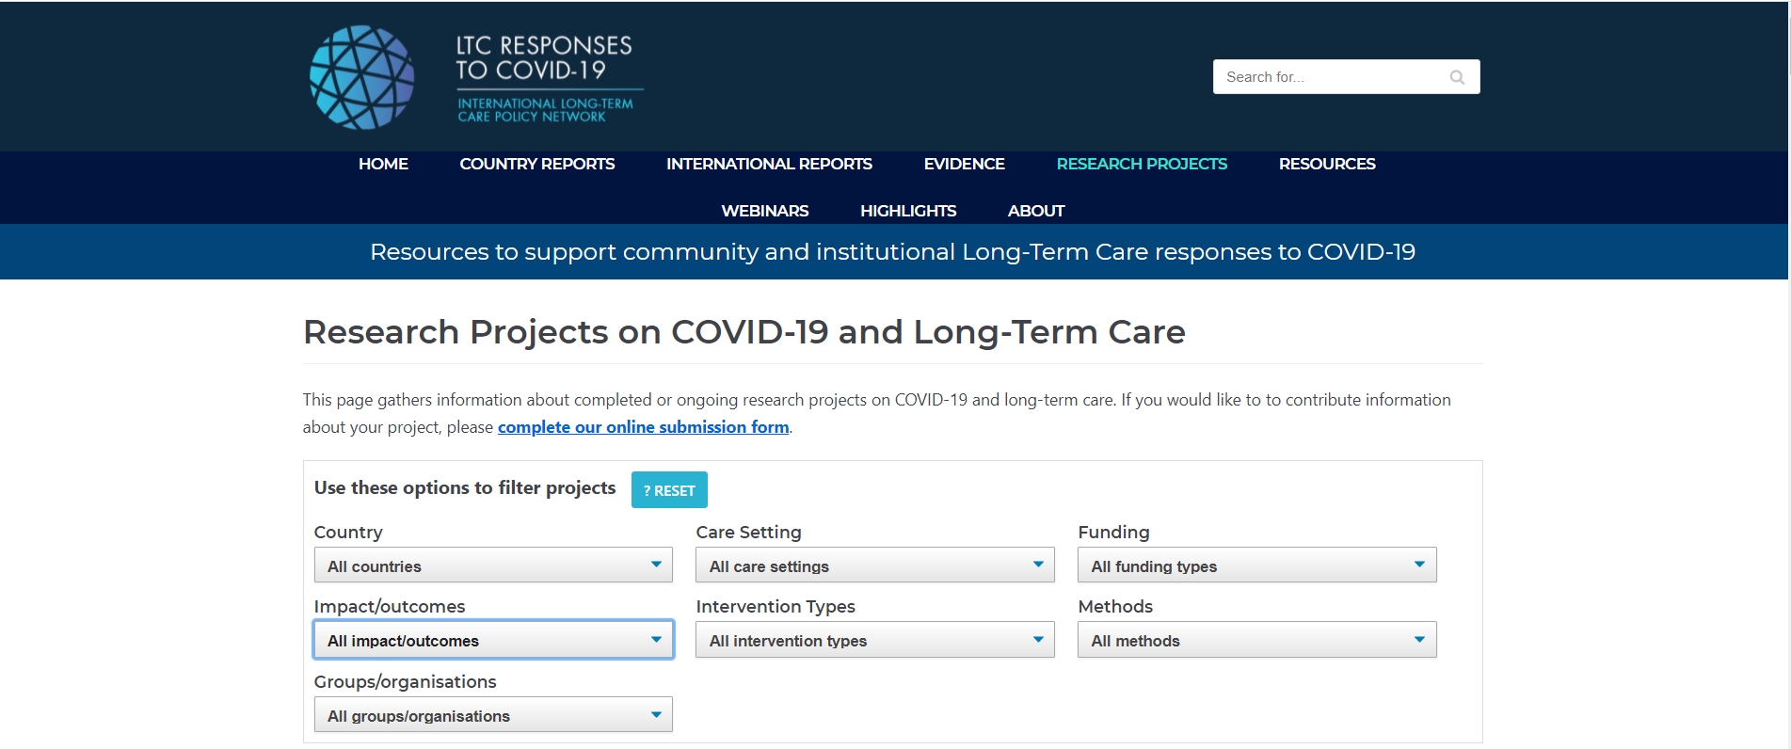
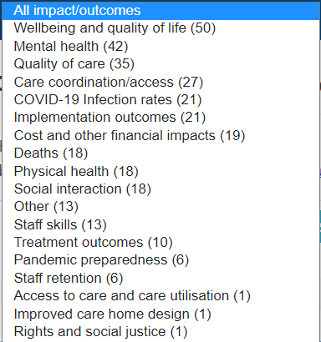
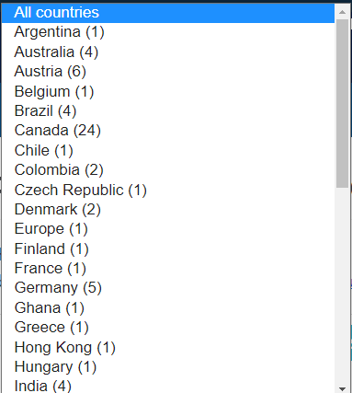
Essential research hub for COVID-19 and LTC
Source: LTCCOVIG.org

Slide 23
International experts sharing views on care homes & LTC
Source: LTCCOVIG.org

Slide 24
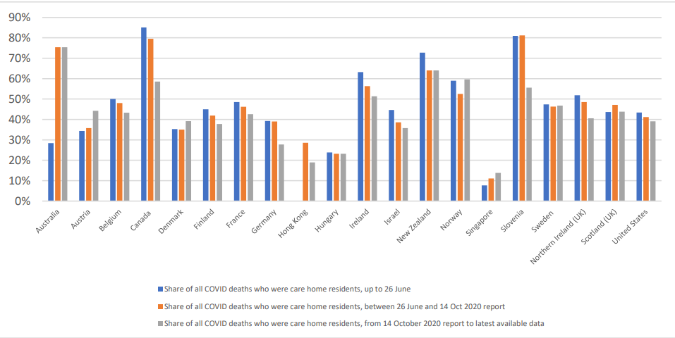
International comparisons of mortality in care homes
Source: Mortality in care homes: international evidence

Slide 25
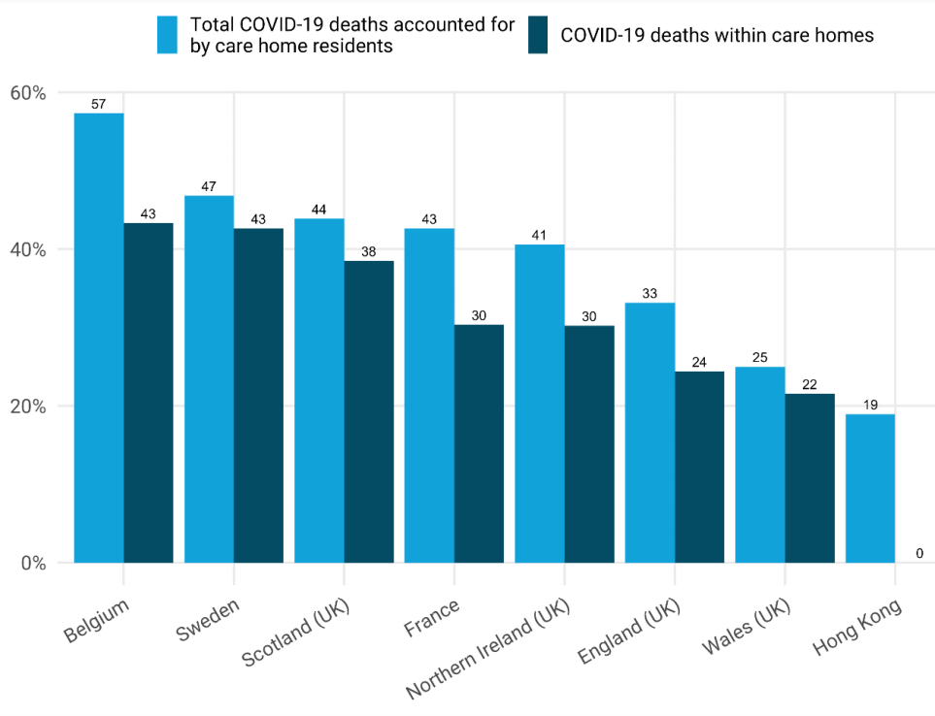
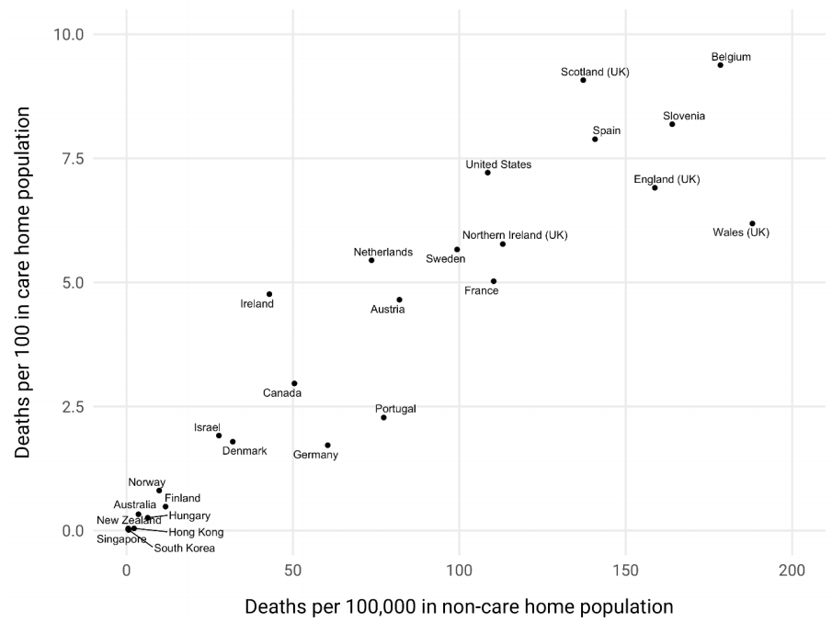
International comparisons of mortality in care homes
Source: Mortality in care homes: international evidence

Slide 26
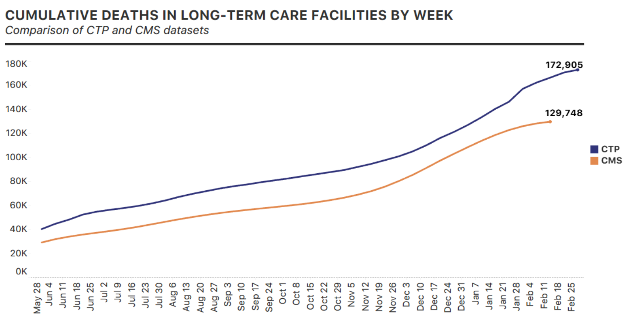
USA: Long-term care COVID tracker
Part of the COVID Tracking Project, established by the Atlantic, bringing together state and federal data on long-term care facilities
Source: Long=term care COVID tracker

Slide 27
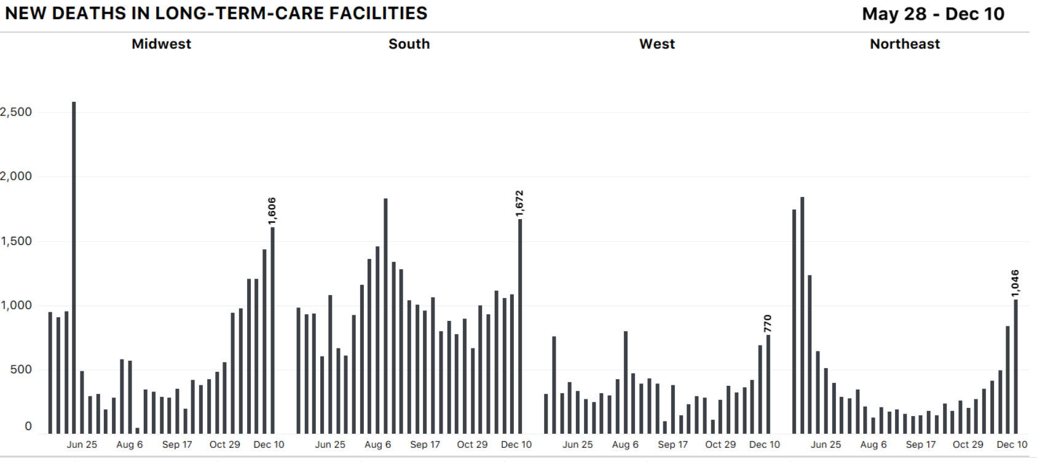
USA: Regional analysis of pattern of LTC mortality
Source: Long term care COVID Tracker

Slide 28
USA: Benefits of vaccinations in nursing homes
Source: Is the End of the Long-Term Care Crisis Within Sight?

Slide 29
Preventing further outbreaks
COIOS Research

Slide 30
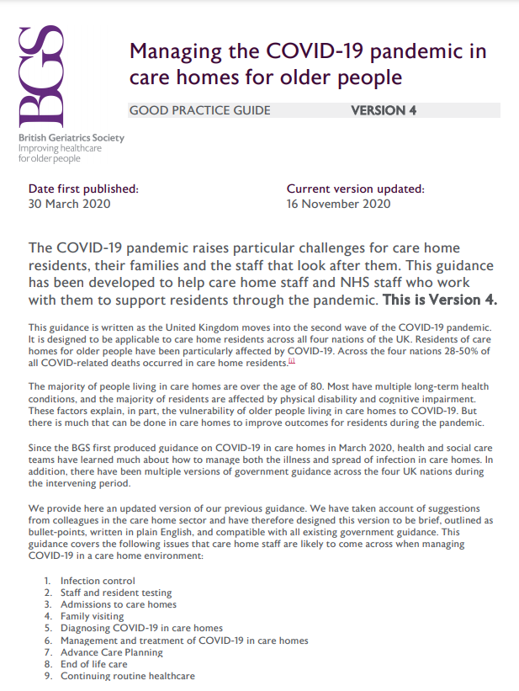
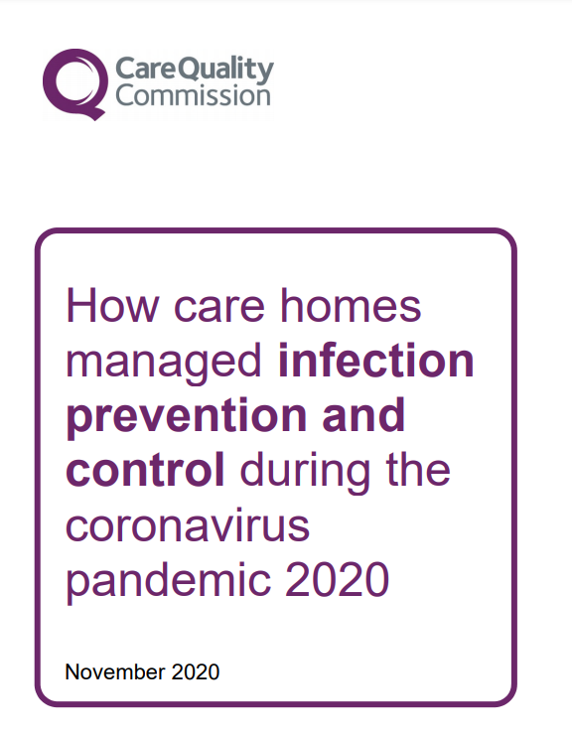
Best practices for care homes going forward
NHS Long Term Plan (2018) committed to roll-out EHCH across England by 2024
as part of Ageing Well Programme
Source: CQC guidance to care homes, British Geriatrics Society,

Slide 31
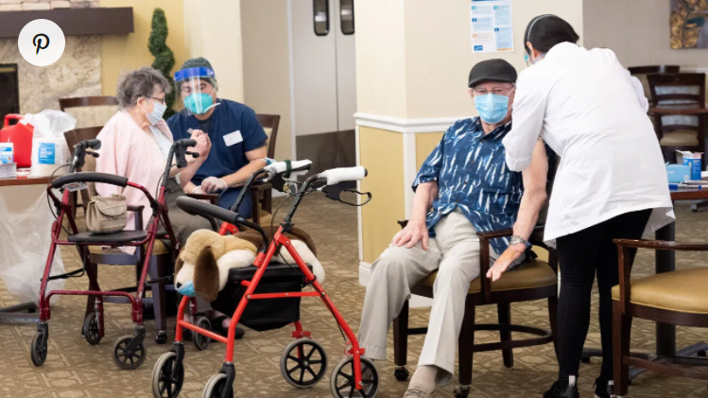
How care homes are trying to prevent outbreaks
Routine testing of staff and residents + awareness of non-classical symptoms - lethargy, lack of appetite and delirium
Change care home layouts to reduce maximum occupancy and allow for segregation of possible, probable and confirmed cases
Discharging patients from “hotzone” hospitals to “quarantine centres” with repeated swabbing over multiple days
Better information systems that monitor outbreaks and link care homes to suppliers
Rapid response teams to be deployed where staff illness significant to maintain continuity of care
Limit staff to one care home, and provide support so not compelled to work when ill
Use of tele-medicine for offsite HCW during pandemic
However, social distancing with PPE may achieve better overall outcomes than blanket visiting restrictions that intensity social isolation.

Slide 32
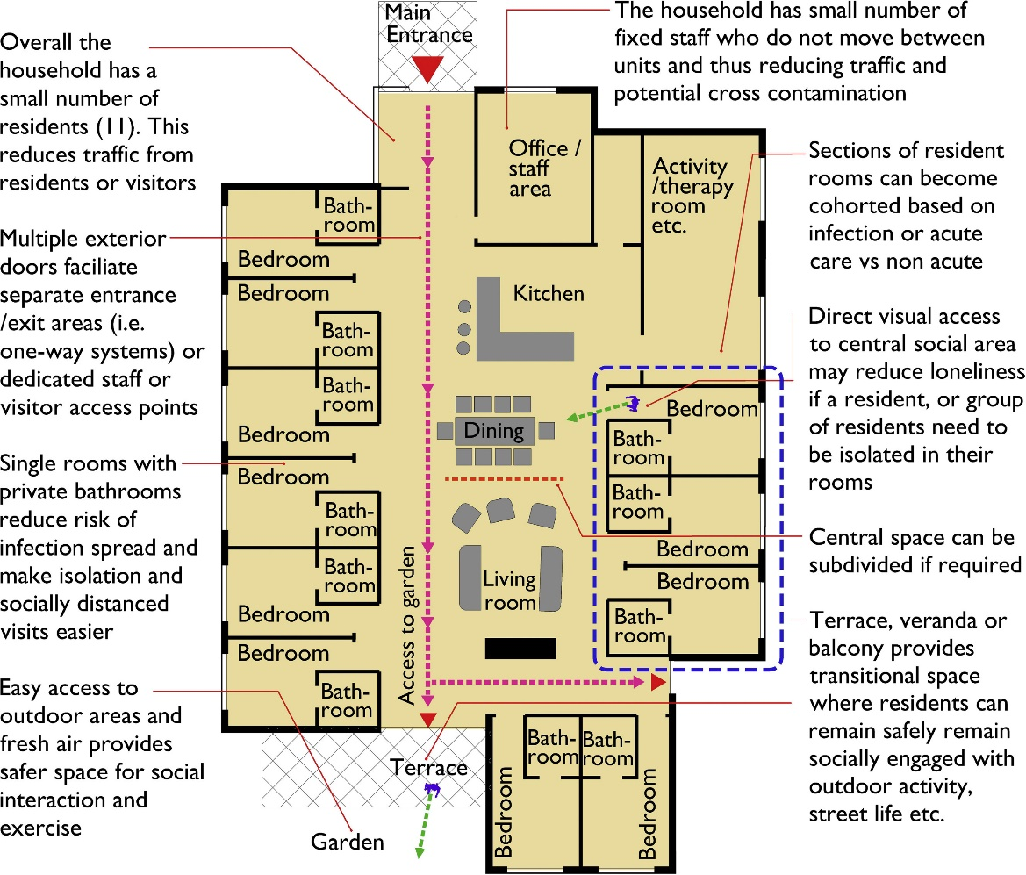
Re-designing care homes in a COVID world
“Household” or “Green Care” model
Preference for autonomous residences with dedicated staff with decentralised care station
10-12 residents with private bedrooms/bathrooms
Onsite therapy and activity rooms
Promote engagement and address directly fear of isolation
Reduce traffic and limit number of access points
Protected outdoor space
Source: Nursing home design and COVID-19

Slide 33
Future of care home sector & adult social care

Slide 34
Future impact of COVID on care home industry
Reduced demand for care home places
Typical occupancy 88%
Occupancy below 85% affects financial viability
Estimated at 79% second half of 2020, will take till November 2021 to recover to pre-pandemic levels
Home care agencies and care homes subject to increased costs
More staff needed to maintain bubbles
Sick pay to deal with staff absence, no sick pay is a disincentive to be tested
Staff shortages require a recruitment drive
PPE requirements

Slide 35
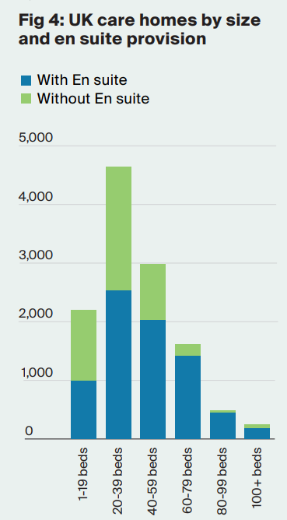
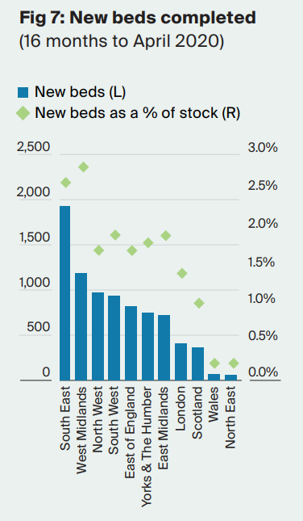
Care homes at risk of closure
Knight Frank predicted in July 2020 that 6,500 smaller, older care homes (140,000 beds) are at risk because properties need to be updated to wet room provision & unable to cope with occupancy loss.
Increasing appetite for home care
92% (YouGov Nov 2020) of over 65s preferred home care over care home
Prior to COVID, challenges for home care over staffing, quality of care and integration with healthcare – desire to move beyond time and task
Source: UK Healthcare Development Opportunities 2020

Slide 36
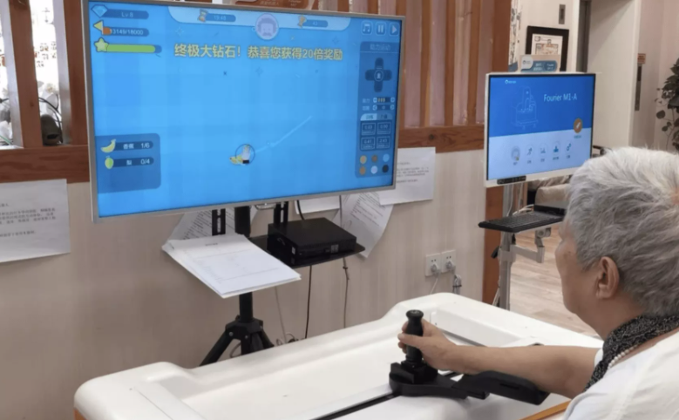
Virtual care homes
Combination of internet technology & support services enable individuals to stay at home with cloud monitoring and one-stop access
135,000 registered in China as at December 2020
Challenges over staffing and quality of service

Slide 37
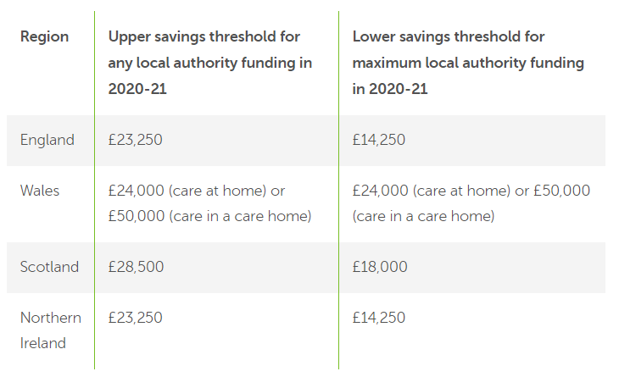
Longer term funding of social care in UK
30 year debate of funding solutions, referencing social insurance models elsewhere. Care Act 2014 reforms have been delayed and suspended.
Estimated that UK adult social care will require extra £7bn in 2023/4 at least to meet demographic pressures, fund minimum wages and protect individuals from catastrophic costs (1 in 10 face £100,000+). Actual costs of adequate social care likely to be much higher.
White paper (Feb 2020) from DH&SC under consultation: Integration and innovation: working together to improve health and social care for all
Asset means testing include primary residence when vacated for care homes; exclude for home care
Insurance solutions such as equity release and investment require clarity over funding and level at which costs are capped
Joint report by IFoA and Independent Age “Will the Cap Fit? What the government should consider before introducing a cap on social care costs”
Source: Health & Social Care Committee: Social care – funding and workforce

Slide 38
Questions
Comments
Expressions of individual views by members of the Institute and Faculty of Actuaries and its staff are encouraged.
The views expressed in this presentation are those of the presenter.
Very happy to answer any questions that you may have after the webinar. If so, please contact me at dan.ryan@coios.health.

